Slide 1




CLTV Calculation e-Commerce Project
Springboard Capstone Project 1
Dia Ganguly

Slide 2
Data Visualization

Slide 3
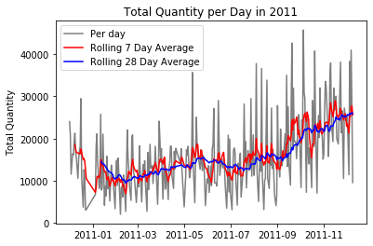
Online retail data by transactions for a full year
The graph on the left indicates that sales sharply increases in November. This shows seasonality in sales.

